Slide 1
Tennessee Food Freedom Act 2025
Mark Morgan, Professor and Extension Specialist
Mark.Morgan@Tennessee.edu
Damla Dag Ertop, Extension Assistant Professor
ddag@utk.edu

Slide 2
Disclaimer: This presentation is for educational purposes only and does not constitute legal advice nor is it intended to be a substitute for the services of a competent legal professional.

Slide 3
Tennessee Food Freedom Act - History
Before the Tennessee Food Freedom Act (2022), the production and sale of home-processed foods went through various iterations of exemptions/rules. Here is a brief summary.
Prior to 2007, rules prohibited the sale of home-processed foods.
2007 – Beginning of TN “Cottage Food Laws”
Allowed non-potentially hazardous foods
TDA licensed home-based producers and inspected kitchens
Producers were required to complete Food Safety Training – UT’s Domestic Kitchen Course
Notes:
Before the current Tennessee Food Freedom Act went into effect, the production and sale of home-made foods went through various iterations of exemptions/rules.
Prior to 2007, rules actually prohibited the sale of home-made foods to the public.
In 2007 home-based food processors were allowed to make "non-potentially hazardous" foods like baked goods, hard candy, and jams/jellies) from their homes and sell them within the state.
As part of the rule, producers had to be inspected and licensed by the TDA, as well as complete a Tennessee Food Safety Certification Course offered by UT Food Science.

Slide 4
Tennessee Food Freedom Act - History
2012 –Inspection/permitting a home kitchens became optional
Signage required: "These food products were made in a private home not licensed or inspected.“
2017 – TDA stopped all Licensing/permitting of Domestic Kitchens
Producers could still only make non-potentially hazardous foods
Allowed foods could be made in:
A home kitchen
Community kitchen (shared space)
Commercial kitchen (church, restaurant, or school, for example)
Notes:
In 2012, the requirement for inspection and permitting a home kitchen became optional. If a producer was not permitted, signage had to be displayed stating: "These food products were made in a private home not licensed or inspected."
Then In 2017, the TN laws went through a significant change again. Licensing and permitting of domestic kitchens was ended.
Producers could still only make non-potentially hazardous foods but there was no limitation on where the foods were produced. Foods could be made in their home, a community or commercial kitchen.
Because there is no more licensing/inspection with TDA, there is no longer a list of all domestic kitchen producers in TN. As we will touch on later, this is why proper labeling information is so important under the current rules.

Slide 5
Tennessee Food Freedom Act - History
2022 – First version of TFFA passed by the state Legislators
Allows only “homemade food items” (and created a definition)
“Homemade food items” had to be non-TCS vs non-potentially hazardous
All producers had to move operations back to their private residence! (no community or commercial kitchens allowed without a permit)
Homemade food items could NOT include (or contain):
alcoholic beverages,
meat, fish, eggs
dairy products, or other TCS foods
Side note – many complaints from “cottage food” producers…
Complaints about limitations
Complaints about location restrictions
Complaints about labeling requirements
Notes:
In 2022, the Tennessee Food Freedom Act was passed.
This expanded the types of products that could be produced by changing the wording from "non-potentially hazardous“ to “non-TCS” homemade food items).
The non-TCS foods definition allowed anything that was “shelf-stable” (essentially). This meant that canned foods were now allowed to be produced and sold under the TFFA.
However, the drawback was it only allowed home-based processors.
This sent everyone working under the previous “Cottage food laws” in Tennessee back to their private residence!

Slide 6
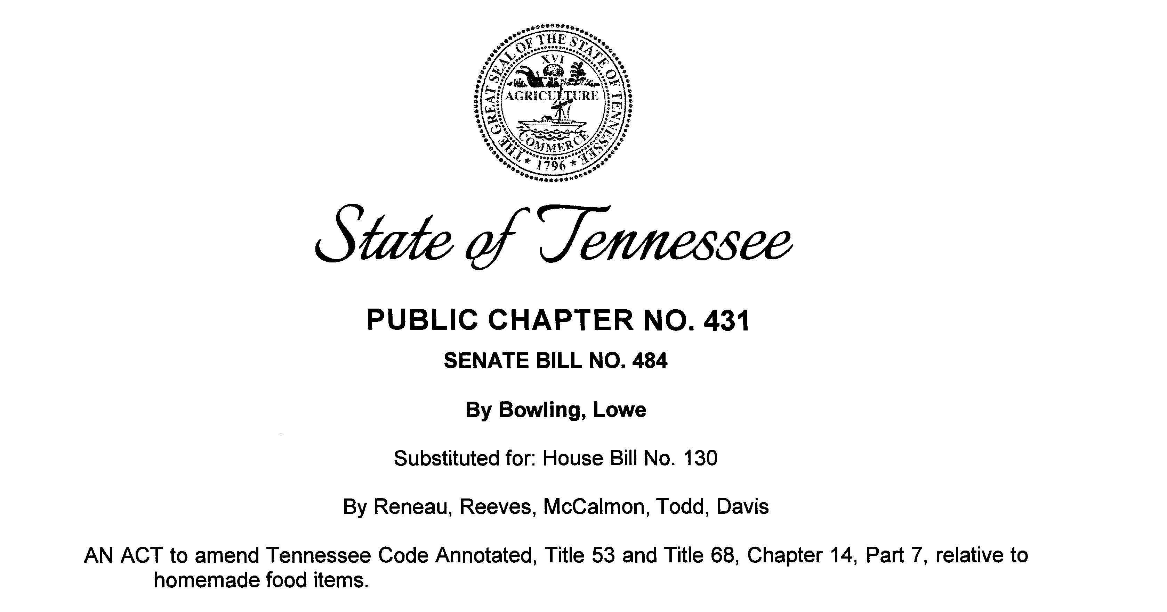
Tennessee Food Freedom Act – Current Version
2025 – CURRENT VERSION OF TFFA
TFFA was modified (by the state legislators) to expand allowable foods
Still allows non-TCS homemade food items made at a private residence
Added most TCS foods with some limitations and restrictions
Notes:
In 2025, the TFFA was once again modified by state legislators to address one main complaint about what homemade food items were allowed and what were not!
The confusion about non-TCS vs TCS food items, and the desire to make and sell many items that were previously not allowed, was addressed in this version of the act.
The same non-TCS homemade foods items were still allowed but now most TCS food items were also added.
The Act only has a few limitations in the definition of a homemade food item and lists a few other restrictions on ingredients or final products.

Slide 7
Tennessee Food Freedom Act - 2025
New changes went into effect July 1, 2025
What is the TFFA exactly?
The TFFA is an exemption in the state’s food manufacturing regulations for homemade food items produced and sold in Tennessee.
From Tenn. Code Ann. 53-1-118:
“… the production and sale of homemade food items under this chapter are exempt from all licensing, permitting, inspecting, packaging, and labeling laws of this state, except when the department of health is investigating a reported foodborne illness.”
However, there are some limitations in the Act itself regarding the types of homemade food items and where they can be sold, so this first statement is sometimes misleading!
Notes:
The current version went into effect July 1, 2025!
The TFFA is an exemption in the food manufacturing regulations for homemade food items made and sold in Tennessee. Most people operating small food businesses under the TFFA and other state laws use the term "cottage food laws". The TFFA is essentially Tennessee’s cottage food law.
The exemption in the Tennessee laws is found under section 52-1-118 of the Tennessee Code and states the following:
“… the production and sale of homemade food items under this chapter are exempt from all licensing, permitting, inspecting, packaging,
and labeling laws of this state, except when the department of health is investigating a reported foodborne illness.”
However, there are some limitations in the types of products sold and where they can be sold.

Slide 8
Definition of a Homemade Food Item?
“Homemade food item” means a food item, including a non-alcoholic beverage, which is produced and, if packaged, packaged at the private residence of the producer;
(Tenn. Code Ann. §53-1-102)
This is the part of the Code that requires these homemade food items to be made at your private residence.

Slide 9
What homemade food items can be sold under the 2025 – TFFA?
TCS homemade food items must:
Not include unpasteurized milk or foods that are, or that contain, alcoholic beverages, fish, shellfish products, meat, meat byproducts, or meat food products;
Non-TCS, homemade food items must also:
Not include unpasteurized milk or foods that are, or that contain, alcoholic beverages, fish, shellfish products, meat, meat byproducts, or meat food products;
However, this list of restrictions was lost in the current code.
We’ll see later that poultry meat is allowed…
Notes:
The new Act clearly states which restrictions are present for TCS, homemade food items.
However, it makes sense that this same list applies to non-TCS homemade food items even though this wording is missing in the law.

Slide 10
What are TCS and non-TCS Foods? How do you make the distinction?
Time/Temperature Control for Safety or not?
Notes:
Both TCS and non-TCS food items made in a home kitchen for sale to the public are allowed under the TFFA.
However, there are some restrictions on where and how TCS foods can be sold!
So, the next several slides will explain the difference between TCS and non-TCS foods.

Slide 11
TCS vs non-TCS Foods
Time/Temperature Control for Safety Foods (TCS)
require time and/or temperature controls to limit rapid and progressive growth of microorganisms or toxin formation that will make someone sick
Most refrigerated or frozen foods are considered TCS
Non-Time/Temperature Control for Safety Foods (non-TCS)
do not require time or temperature control for safety to limit rapid and progressive growth of microorganism or toxin formation
Shelf stable (or preserved) foods are commonly considered non-TCS
Keep Refrigerated
Notes:
Time and Temperature Control for Safety Foods (TCS) are foods that require time and/or temperature control to limit pathogenic microorganism growth or toxin formation.
These food items must be kept hot or cold during distribution and sale. Most will be held under refrigeration!
Non-Time and Temperature Control for Safety Foods (non-TCS) are foods that do not require time and/or temperature control for safety to limit rapid and progressive growth of microorganisms
Shelf stable foods (those adequately preserved and not stored under refrigerated temperatures) are commonly considered non-TCS.
If a food product is only being refrigerated or frozen for quality purposes and not safety purposes (for example freezing bread, refrigerating candies/chocolates, etc.) it may still be considered non-TCS.

Slide 12

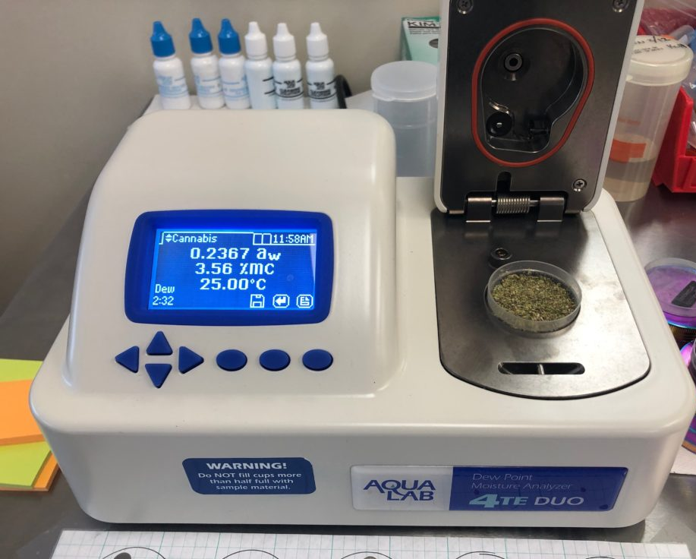
pH and Water Activity are two properties used to distinguish TCS and non-TCS foods
pH – measure of degree of acidity
Most foods are acidic or slightly acidic with pH less than 7.0
Water Activity (Aw) – measure of moisture available for microbial growth
Aw ranges from 0 – 1.0
Aw = 0.85 is similar to relative humidity of 85%
Combinations of these two properties can be used to identify non-TCS foods
pH electrode
Water activity meter
Notes:
pH and water activity are two parameters that are used in the Food Code (and other regulations) to distinguish TCS and non-TCS foods.

Slide 13
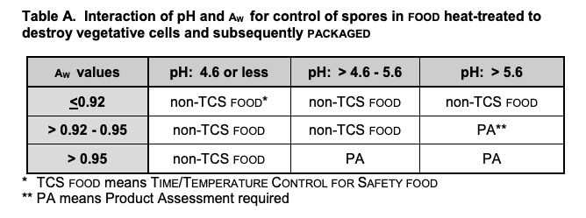
TCS vs non-TCS Foods
Must be a validated heat-treatment (kills 99.999%)
Product may not be shelf-stable and can still spoil
Notes:
This is the first of two Tables directly from the Food Code. This table applies to products heated to destroy vegetative microorganisms (i.e. those actively growing) and subsequently packaged to prevent recontamination.
The highlighted example shows that any heat-treated and packaged food item with a pH between 4.6 and 5.6 with a water activity between 0.92 and 0.95 would be considered non-TCS.
However, the heat treatment must be “validated” to show that it will destroy approximately 99.999% (referred to a 5 logs) of vegetative microorganisms in the food.
BBQ sauce hot filled into a glass bottle and sealed would be a good example of this type of food item.
One word of caution here is that these combinations of pH and water activity may not necessarily make the product shelf-stable!! It may still spoil or mold if conditions are right.
Combinations of pH and water activity that are labeled with “PA” indicate that a product assessment is required by a process authority to determine if the food item will support the rapid growth of microorganisms that can make someone sick.

Slide 14
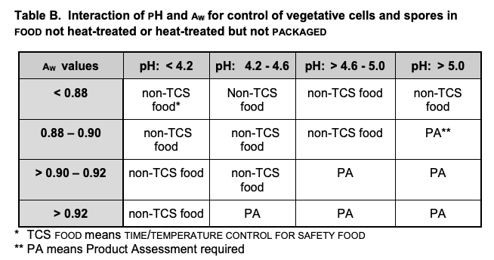
TCS vs non-TCS Foods
Notes:
This second table from the food code (Table B) is applied for products that are not heat treated, or heat treated but not packaged.
Mayo is an example of a food not heat treated.
Baked goods or pastries are an example for the foods heat treated and not packaged.

Slide 15
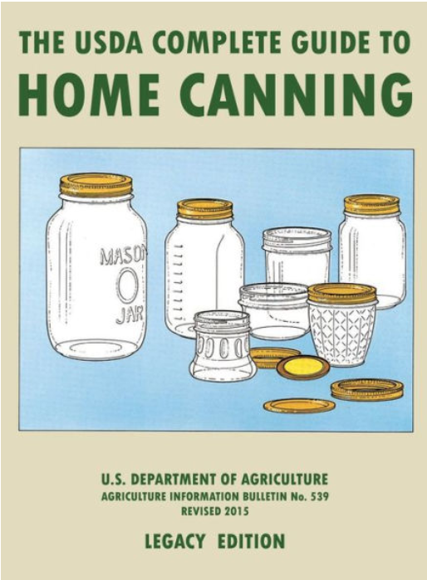
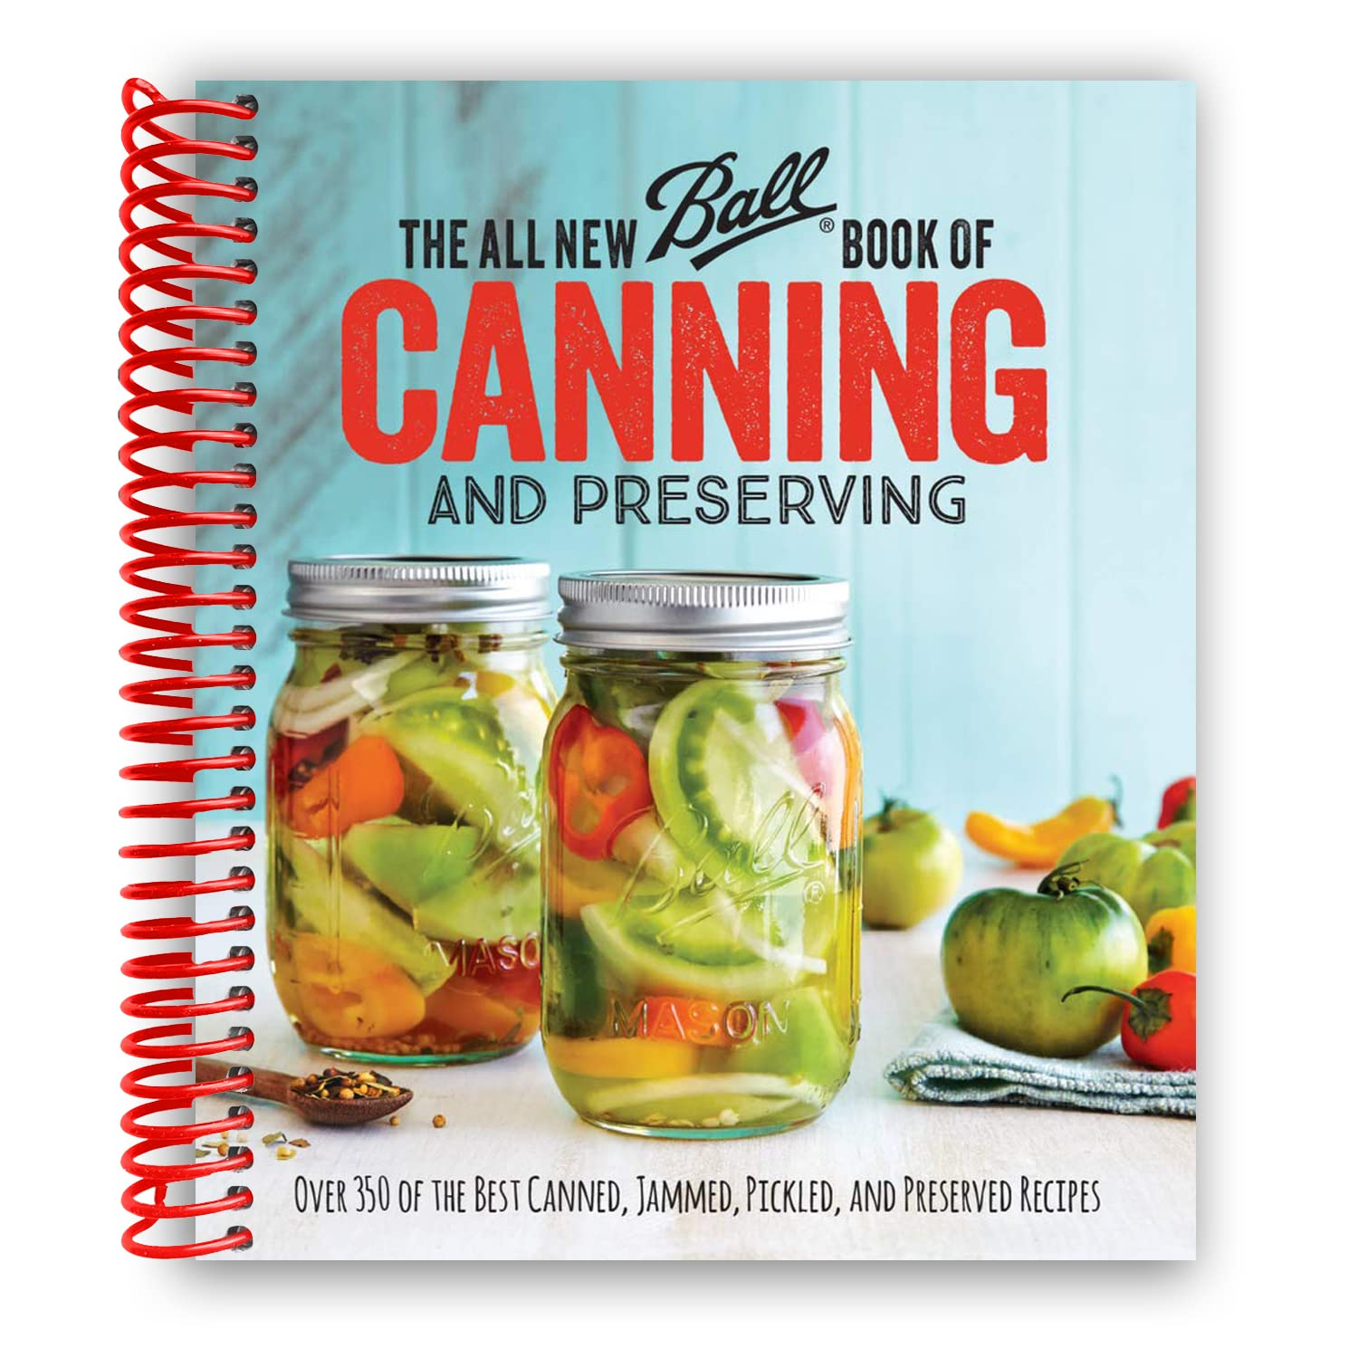
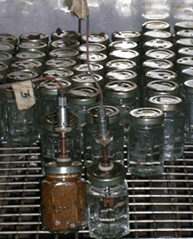
What are some sources of validated thermal processes?
Canned foods which have undergone a validated thermal process are considered non-TCS.
The processes applied to these items should come from a recognized publication or a process authority.
Validated sources
Process Authority

Slide 16
Examples of TCS vs non-TCS Foods
NON-TCS examples | Why these are non-TCS
Acidified canned foods: pickles, salsas, relishes, BBQ sauce | Low pH due to adding acid and water bath canning process to make shelf-stable
Low acid canned foods: vegetables, beans, pepper jam with pH > 4.6 | Proper pressure canning process required make safe and shelf-stable
Bottled condiments: mayonnaise, ketchup, mustard, hot sauce | Low pH and canning process required to make shelf-stable
Fermented foods: sauerkraut, kombucha | Low pH achieved by proper fermentation
Dairy products: hard, aged cheeses, butter | Low Aw and/or low pH
Pasteurized and bottled beverages: teas, fruit drinks, lemonade | Low pH & proper heat treatment during bottling required to make shelf-stable
TCS examples | Why these are TCS
Fresh: slaw, salsa, pico de gallo, cut vegetables, salads | High pH and high Aw Neither parameter prevents pathogen growth
Fresh cut vegetables or fruits | High Aw and/or High pH
Freshly made condiments | pH or Aw may allow bacteria to survive or grow if not heat processed
Dairy products: pasteurized milk, fresh cheese, yogurt | High Aw and pH
Beverages not heat treated: fresh apple cider | High Aw and lack of heat treatment may allow pathogens to survive
This table lists examples of foods considered TCS or non-TCS and the reasoning why.
Notes:
This table lists examples of foods considered TCS or non-TCS and the reasoning why.
There are a few important notes for this table.
Frostings may or may not be considered TCS, we recommend having the water activity tested.
No dried meats, including jerky, are allowed under the TFFA unless made with Chicken.
Products containing more than 0.5% alcohol are not permitted under the Tennessee Food Freedom Act due to such products being regulated by the Tennessee Alcoholic Beverage Commission.

Slide 17
TCS vs non-TCS Foods
NON-TCS examples | Why these are non-TCS
Dried foods: pasta, spice blends, rice, fruits, vegetables, nuts, granola | Low Aw
Canned fruits, jams, jellies, syrups | pH less than 4.6 due to fruits and/or Aw < 0.85 due to high sugar content Most products thermally processed to make shelf-stable
Baked Goods: Breads, cookies, cakes, etc. | Low Aw Frosting or filling must also have low Aw (< 0.88)
Candy, chocolate, caramels, peanut brittle, etc | Low Aw
TCS examples | Why these are TCS
Cooked: rice, pasta, vegetables | High Aw after cooking
Fresh cut fruits | High Aw and no thermal process
Pastries or baked goods with cream filling or filling added after baking | Typically High Aw Testing recommended to show Aw < 0.88
Potentially caramel apples | Bacteria has been found to grow around sticks placed in caramel apples
Notes:
This table lists examples of foods considered TCS or non-TCS and the reasoning why.
There are a few important notes for this table. Frostings may or may not be considered TCS, we recommend having the water activity tested. No dried meats, including jerky, are allowed. Products containing more than 0.5% alcohol are not permitted under the Tennessee Food Freedom Act due to such products being regulated by the Tennessee Alcoholic Beverage Commission.

Slide 18
Safe Handling of TCS Foods
Common TCS foods:
animal-based products (meat & eggs)
plant-based products that have been heat-treated (cooked)
raw seed sprouts, cut melons, cut leafy greens, cut tomatoes
fresh garlic-in-oil mixtures
refrigerated or frozen products
TCS foods must be kept out of the “Danger Zone” between 41 °F – 135 °F
or
TCS foods must be discarded after 2-4 hours if not temperature controlled (2022 Food Code)
Something to consider: Are you willing to throw away a TCS product if not sold within 2-4 hrs?
Notes:
Common foods that are categorized as TCS include animal based products raw or heat-treated (meat, poultry, fish, egg and dairy products), plant based products that have been heat-treated (excluding canned foods), raw seed sprouts, cut melons, cut leafy greens, cut tomatoes, fresh garlic-in-oil mixtures, and refrigerated or frozen products.

Slide 19

Tennessee Food Freedom Act - 2025
General LIMITATIONS on Homemade food products:
must be produced at your private residence
must be sold only within the state of Tennessee
must meet specific labeling requirements (in the Act)
Non-TCS food items:
can be sold in person or remotely, or
through a third-party vendor such as a grocery store
TCS food items: must be sold in person direct to consumers only
TCS foods items: must be kept under temperature control:
Refrigeration (less than 41 °F) during storage/transport and while being sold
Notes:
The Tennessee Food Freedom Act still has the general limitations that:
All homemade foods must be produced at your private residence
Must only be sold within the state of Tennessee
Must meet specific labeling requirements
Non-TCS homemade foods can be sold in person or remotely, or through a third-party vendor such as a grocery store.
TCS foods has increased the types of food products that can be produced at a private residence and sold within the state .
Must be sold in person direct to consumers (no third party sales allowed)
Must be handled (distributed and sold) under temperature control at all times, or discarded after 4 hrs of non-temperature control.
Should be clearly communicated to the customer that the food item is TCS or requires refrigeration!

Slide 20
Tennessee Food Freedom Act - Poultry
Other changes in the 2025 TFFA
Homemade TCS food items can include poultry or poultry food products if:
A) the home-based business is a compliant poultry producer with less than 1,000 poultry and uses only exempted poultry products
B) complies with 9 CFR 381.10(d) and uses only inspected poultry products bearing the official mark of inspection
For example, chicken purchased at a grocery store
Notes:
This change in the 2025 TFFA is somewhat obscure and confusing. But since there are two exemptions for the use of poultry products under the USDA regulations:
one for small producers/growers of poultry
One for retailers or restaurants using purchased, inspected and passed poultry products.
These two exemptions allow the use of poultry meat in homemade food items under the TFFA!
Red meats such as beef, lab, and pork are still not allowed due to USDA regulations that apply in the state of Tennessee.

Slide 21
Tennessee Food Freedom Act - 2025
The TFFA shall not impede the department of health in an investigation of a reported foodborne illness
The Tennessee Department of Health may require to access homemade food processing areas, if necessary, when investigating a foodborne illness
Health claims are not allowed on labels for homemade food items produced under the TFFA
Homemade food items produced under the TFFA are not allowed to be served or used as ingredients in a restaurant, food truck, or catering service
Since these food service establishments must follow the Food Code, sourcing ingredients from uninspected producers is not allowed
Notes:
As with previous iterations of our “cottage food laws” producers have to allow the Tennessee Department of Health to access the food processing facility (i.e. private residence) if necessary to ensure public safety. This would most likely occur if a foodborne illness was possibly linked to a homemade food item.
One important note is that all producers who were under the previous “cottage food laws” now fall under the TNFFA and all its rules. There are no exceptions in this exemption from licensing/inspection.
For some previous producers this may mean updating labels and/or moving from a community kitchen to their private residence (or becoming a licensed food manufacturer).
Since any health claims made on labels of foods are reviewed and controlled by the FDA, it is implied that health claims are not allowed on the labels of homemade food items under the TFFA.
Also, one important limitation is that homemade food items produced under the TFFA are NOT ALLOWED to be served or used as ingredients in a licensed food establishment such as a restaurant, food truck, or catering service! This is because these food service establishments must follow the Food Code and it requires sourcing ingredients from approved vendors.

Slide 22
Labeling Requirements for foods made under the Tennessee Food Freedom Act
Notes:
This section describes the labeling requirements for foods manufactured in a home kitchen under the Tennessee Food Freedom Act.
Each state’s cottage food laws are usually slightly different. Please check cottage food law resources for your local state.
Nothing has changed in the labeling requirements of the TFFA since its inception! These rules all applied starting in 2022!

Slide 23
Labeling Requirements for TFFA
A key requirement in TFFA is labeling guidelines
Required information
1) Producer information:
producer’s name
home address
telephone number
2) Common/usual name of product
3) Ingredients of the food in descending order based on weight
4) The following statement: “This product was produced at a private residence that is exempt from state licensing and inspection. This product may contain allergens.”
Suggested information – for TCS foods – include “Keep Refrigerated” on the label.
Notes:
A key requirement in TNFFA is labeling guidelines. Federal regulations require more detailed information on all food product labels but the TNFFA gives home-based producers in Tennessee an exemption from many of the federal requirements.
All homemade food products sold under TNFFA must include the following information.
1) Producer contact information including: producer’s name, home address, and telephone number
2) Common/usual name of product
3) Ingredients of the food in descending order based on weight
4) The following statement: “This product was produced at a private residence that is exempt from state licensing and inspection. This product may contain allergens.”
No weight of the product is required under the TN FFA, but it can optionally be included but then must be accurate to comply with the state’s weights and measures regulations.

Slide 24
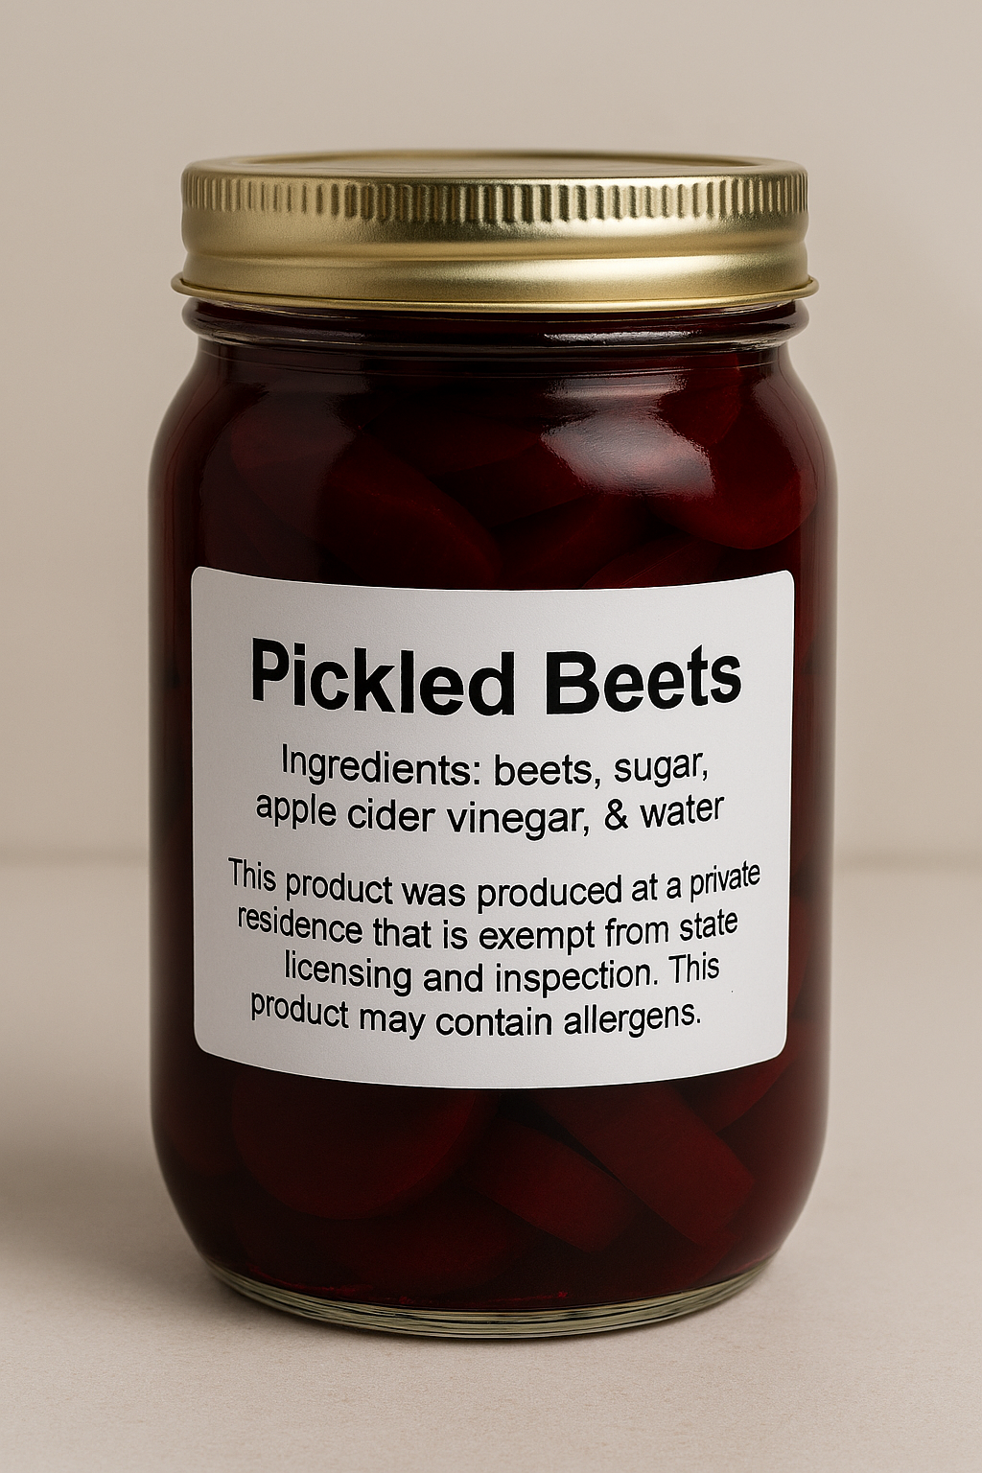
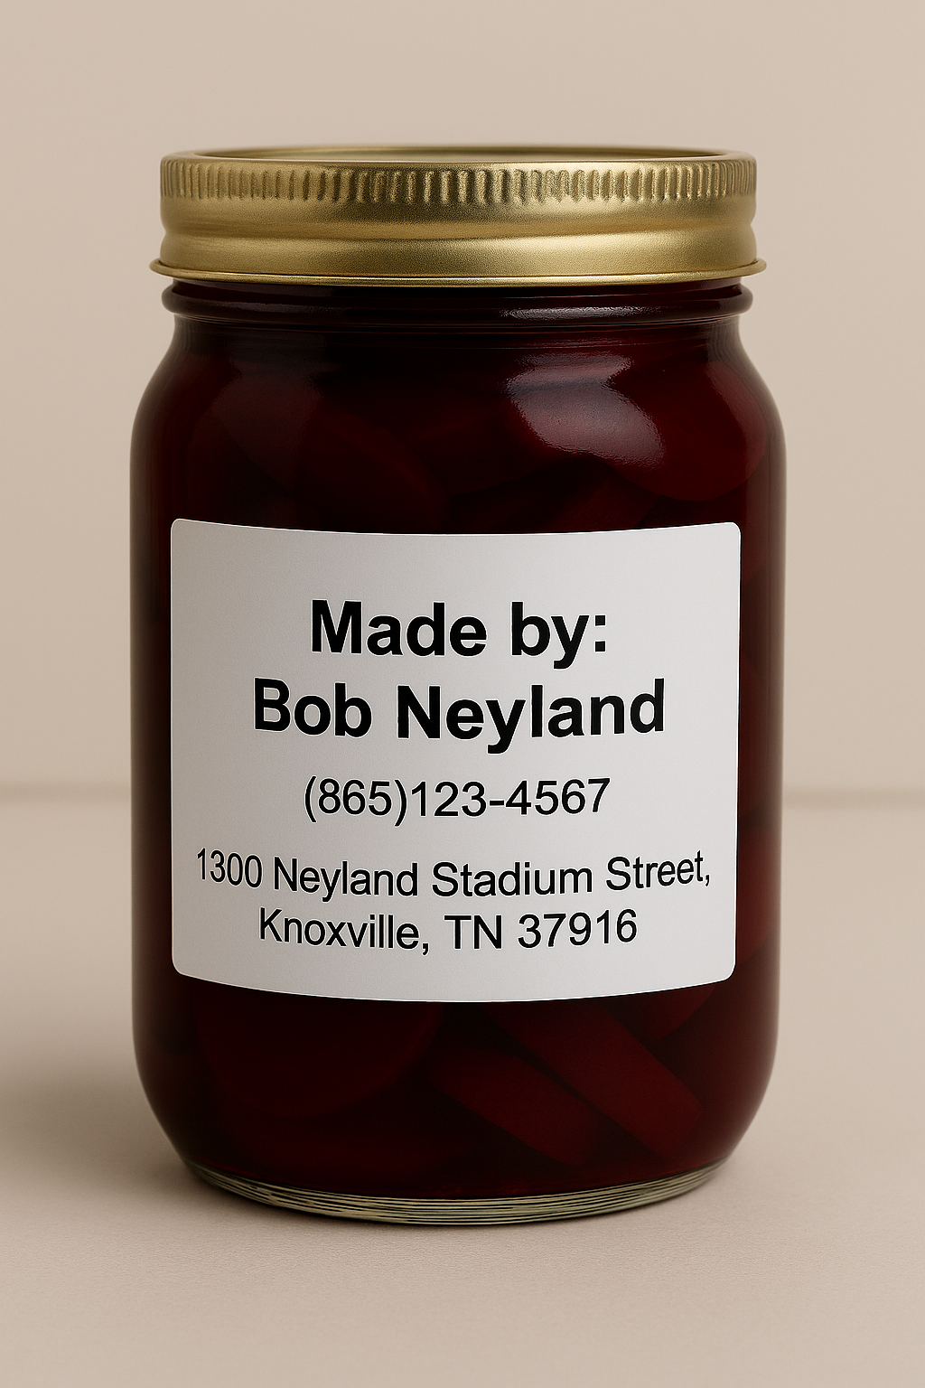
Notes:
These are some examples of labels that could be used. Notice how the combination of the front and back labels identify product, its ingredients, the required disclaimer statement, the producer’s name, phone number, and address where the products were made.

Slide 25
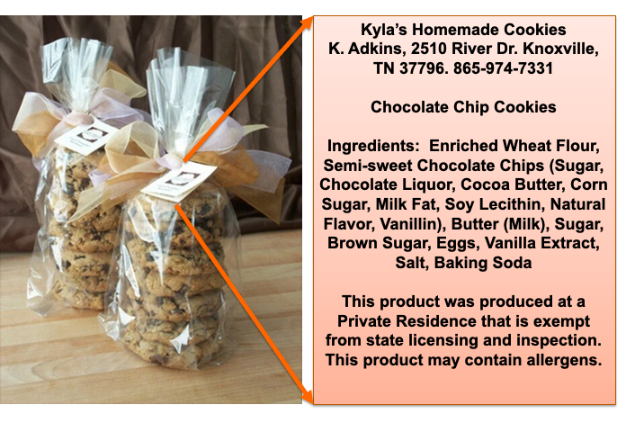
Labeling Example (with sub-ingredients)
Notes:
This is an additional example of labels that could be used. For this label, notice that the sub ingredients for “semi-sweet chocolate chips” is also included in the ingredient list! This is where some allergens may be hiding!

Slide 26
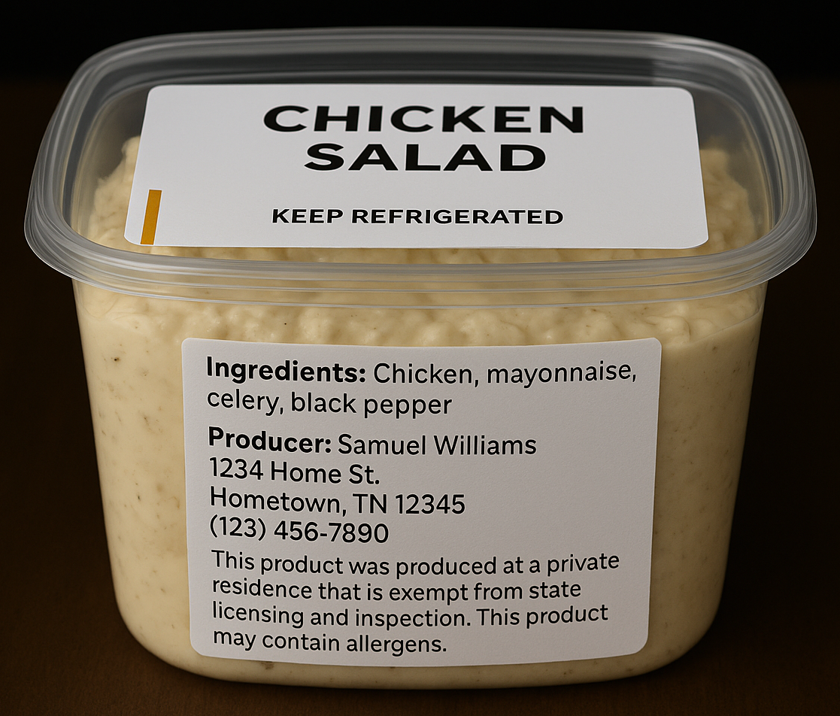
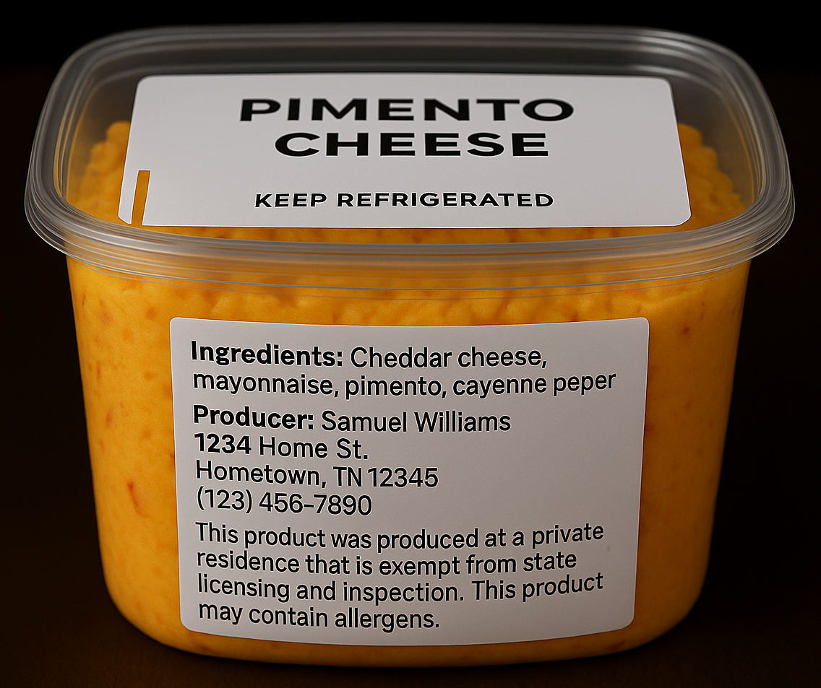
TCS foods Examples
Notes:
Here are some examples of labels for TCS foods, chicken salad and pimento cheese.
Notice the suggested addition of “Keep Refrigerated” on the label to convey to the customer that these items are TCS and perishable.

Slide 27
TFFA – Labeling Options
There are no alternatives for any of the information required on the label.
If you do not want to have identifying personal information on the label, you need to become a licensed food manufacturer. Then, the manufacturing location is included on the label.
Notes:
There are no alternatives listed in the TNFFA for any of the information required on the label (listing a P.O box is NOT acceptable).
Remember that foods produced under the TNFFA MUST be made at your private residence, so that address is required.
If a producer does not want to have identifying personal information on the label of their product, they may need to explore becoming a licensed food manufacturer in TN.

Slide 28
Labeling - allergens
People with food allergens need to make an educated decision about the foods they buy.
Many times sub-ingredients contain allergens, e.g. “chocolate chips (sugar, chocolate liquor, cocoa butter, milk fat, soy lecithin, and vanilla)”.
Nine major allergens recognized in the US (must be identified): milk, soy, peanuts, tree nuts, fish, shellfish, eggs, wheat, sesame
Notes:
One particularly important reason for this is for people with food allergens to be able to make an educated decision about the foods they buy.
They are unable to do so unless producers are including both the ingredients and sub-ingredients.
Which is why when making the ingredient list for our example chocolate chip cookies the ingredient list should include “chocolate chips (sugar, chocolate liquor, cocoa butter, milk fat, soy lecithin, and vanilla)”.
If a customer was allergic to soy, without including "soy lecithin" as a sub ingredient on a label they would not be aware of the allergen inside the chocolate chip cookies.
Listing allergens found in ingredients and/or sub-ingredients is not an alternative to listing sub-ingredients on your label.

Slide 29
Where does the labeling information go?
Must be on a label (if packaged or sold in bulk)
attached to the product
attached to the bulk container
On a placard - displayed at the point of sale if product is not packaged or sold from a bulk container
On the website - where the product is sold (only non-TCS products sold online)
If product is sold by telephone or custom order, the seller must inform the consumer that the product is produced at a private residence that is exempt from state licensing and inspection

Slide 30
Recommended Good Manufacturing Practices for homemade food producers
Use food grade utensils, equipment, cleaners, sanitizers, packaging materials, and ingredients.
Make sure the workspace and equipment is clean and sanitized.
Exclude pets from the workspace.
Close bathroom, outer doors, and (if possible) kitchen doors.
No evidence of pests (use commercial pest controllers if needed).
Notes:
Wood contact surfaces, especially soft woods, are not a good choice for equipment/utensils such as cutting boards. Wood can break off into food causing a physical hazard. Instead, look into plastic cutting boards.

Slide 31
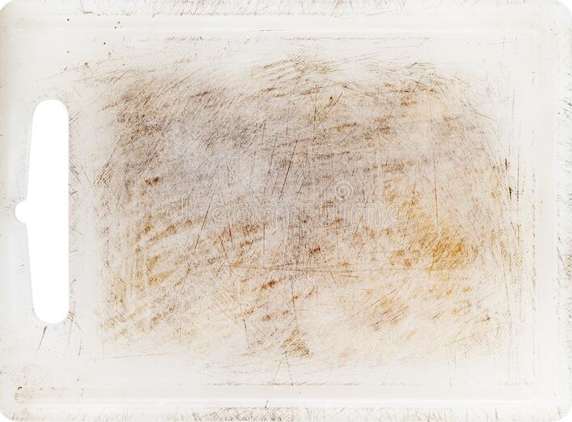
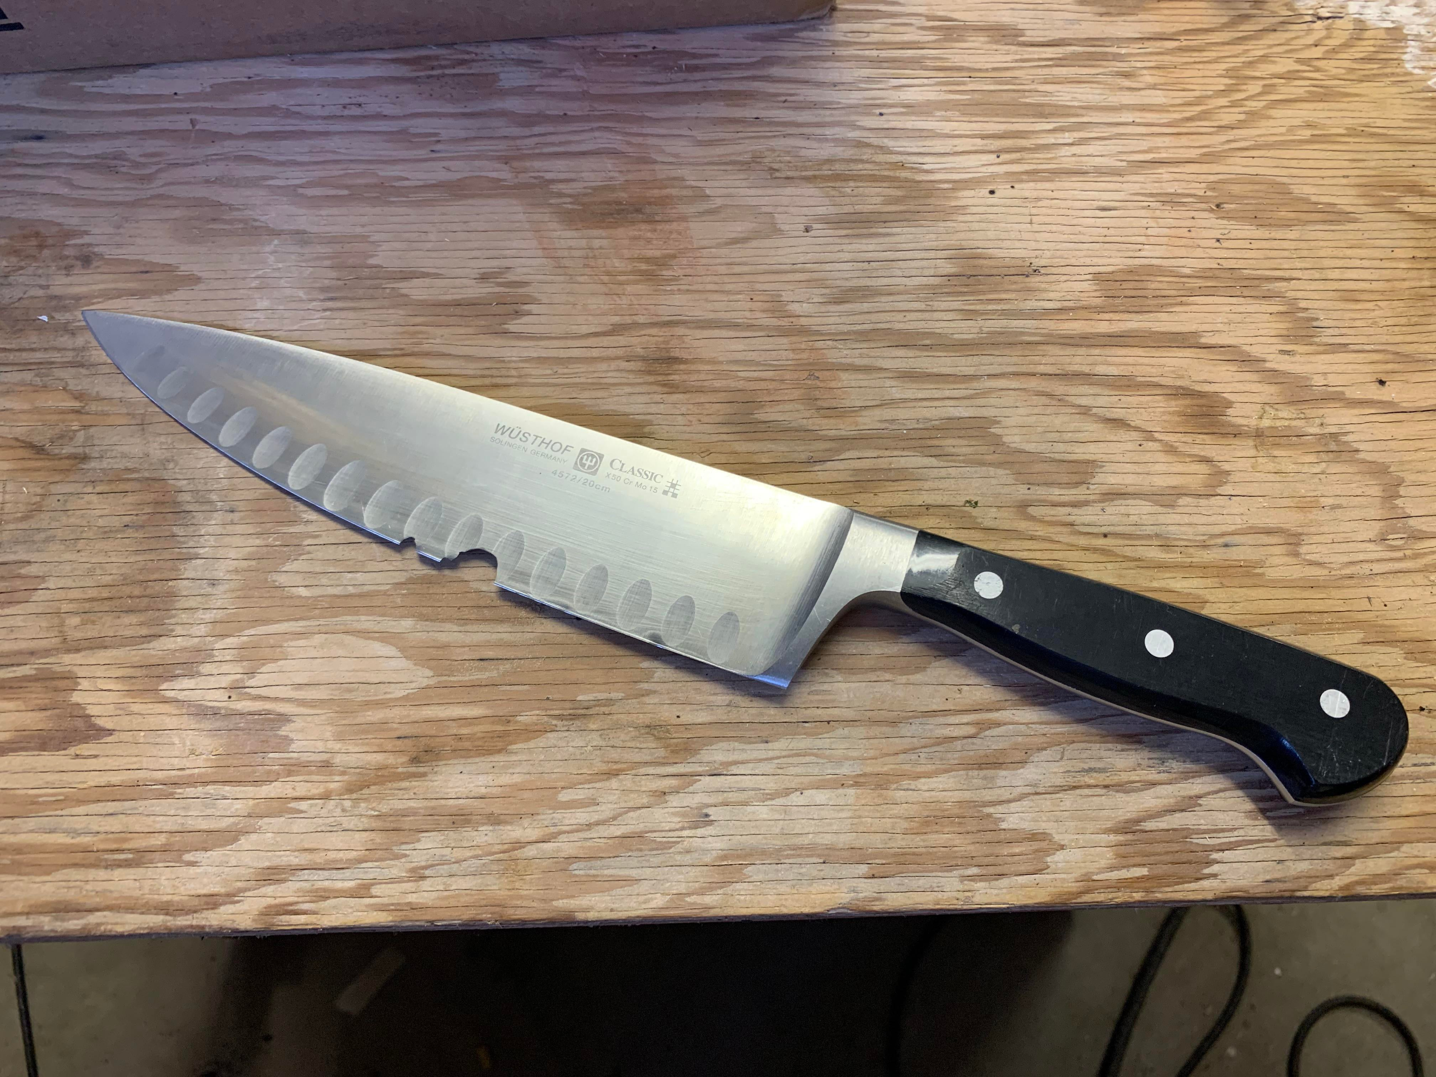
Good Manufacturing Practices
X
Notes:
Make sure equipment/utensils are in good condition. If the cutting board is all scratched up, it might be time to replace it.
Broken or chipped utensils should be discarded.
No wooden cutting boards or rolling pins should be used.

Slide 32

Recommended Recordkeeping
We recommend keeping records with a dedicated recordkeeping binder.
Include information about you and your business
Describe your facility layout, equipment and chemicals used, and pest control procedures
Most important section is batch records describing food items produced each day including:
Source of each ingredient and lot numbers
For canned foods, record processing time/temperature, product pH
Include batch codes For example: 042726-3 (04 = Month, 27= Day ,26 = Year, 3 = Batch number produced that day)
Kyla’s KupKakesBusiness
Notes:
In the binder the first information sheet should be all about you/your business.
Include things like your name, business name, phone number, address, and email address.
The next section in your binder could be all about your products and where they are sold at.
Information like product recipes, results for products you’ve had tested, wholesale locations, and markets you’ve set up at to sell your products would go here.
Another section can be all about your facility regarding chemicals used and pest control. Keeping a log of chemicals used for your business (dish soap, sanitizer, cleaning spray, etc.) can be important in the incident of chemical contamination. This section is where you would also record all things pest control related (like any sightings of pests and any pest control measures taken).

Slide 33
TFFA 2025 - Summary
TFFA requires products to be made at your private residence.
TFFA allows both TCS and non-TCS homemade food items.
Foods cannot include red meats, fish, shellfish, raw milk, or alcohol as ingredients or final products.
TCS food items must be sold only in person to consumers.
Non-TCS food items can also be sold via 3rd parties like grocery stores.
No TFFA homemade food items can be used by restaurants, food trucks, or caterers.

Slide 34
LINKS
TDA link for starting a new food business - https://www.tn.gov/agriculture/consumers/food-safety/ag-farms-food-manufacturing-and-warehousing/startup.html
TDA TFFA link - https://www.tn.gov/agriculture/consumers/food-safety/tennessee-food-freedom-act.html
TDH food service link - https://www.tn.gov/content/tn/health/health-program-areas/eh-program/eh-foodservice.html
UT Food Product Testing link - https://foodscience.tennessee.edu/food-science-extension/#tab-submittingafoodproduct
Notes:
Here are the links for each state agency where you can find more information.

Slide 35

Contact info
Food Science Department
2510 River Drive Knoxville, TN 37996
Phone: 865-974-7331
Email: foodsci_ext@utk.edu
Website: https://foodscience.tennessee.edu/food-science-extension/

Slide 36

Thank you!

