Slide 1
Food Science Programs for Youth
Mark Morgan, Professor and Extension Specialist
Kyla Adkins, Student Engagement Coordinator and Youth Programs Leader
Food Science Department

Slide 2
4 objectives of today’s meeting
1. Explain what Food Science is and isn’t!
2. Review the youth programs related to Food Science
3. Cover some available resources which may be helpful for Food Science Projects
4. Demonstrate what a great Food Science project may involve

Slide 3
Main areas of Food Science
Food Chemistry
Food Microbiology & Safety
Food Processing/Engineering
Food Laws & Regulations
Sensory Science
What Food Science is NOT!
It is NOT cooking: i.e. making spaghetti, pastries, or your favorite dish
It is NOT trying new recipes

Slide 4
Food Chemistry
Functional components of foods
Proteins, carbohydrates, lipids, water, vitamins, minerals, enzymes, food additives, flavors, and colors
Interactions & changes during processing or storage
A food’s chemistry determines its:
Structure, texture, functionality, nutrition, sensory properties, etc.
Example activities:
Level 1 – identify foods high(low) in each category
Level 2 – Examine and compare different levels of “Saturation” for various oils/fats
Level 3 – Demonstrate how some enzymes work.

Slide 5
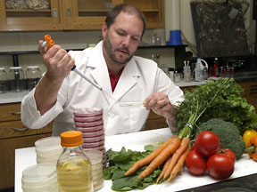
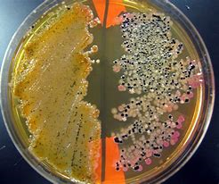
Food Microbiology & Safety
Most raw food materials, ingredients, and final products contain bacteria, yeast, or molds
Microorganisms can be Good, Bad, or Ugly!
Examples of activities relating to microorganisms:
Good: How can microorganisms help produce foods?
Bad: What food-borne microorganisms cause illness?
Ugly: What microorganisms cause food to spoil?
Describe the characteristics and/or processes that make a food product safe? Water activity, pH, canning, dehydration, pasteurization, etc.

Slide 6
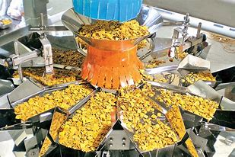
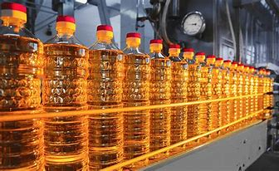
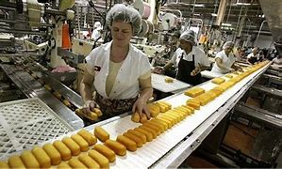
Food Processing & Engineering
Processing turns raw materials and ingredients into foods: i.e. making chips, crackers, or twinkies
Engineers design food processes to “manufacture” foods
Thermal processes are used to “pasteurize” products, i.e. milk, juices, etc.
Fluid flow, heat & mass transfer, thermodynamics all come into play during processing
Examples of activities:
Describe how an HTST pasteurizer works
Describe the processing steps required to make twinkies
Describe how a dehydrator or freeze dryer works

Slide 7
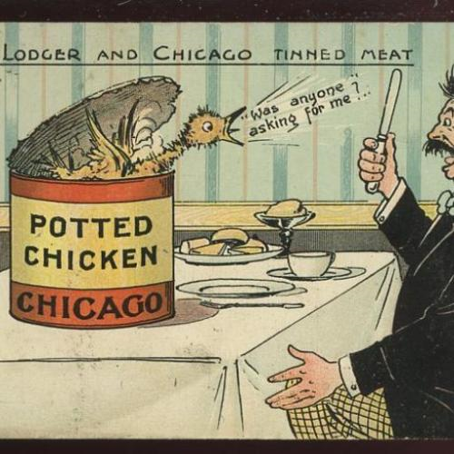
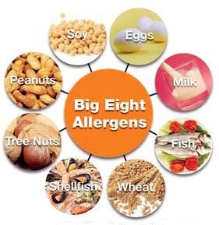
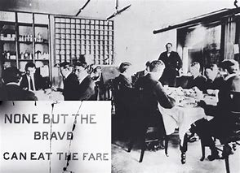
Food Laws & Regulations
Recalled 2017 for botulism
Ensure quality/wholesome & safe products for consumers
Requires pasteurization of some products, i.e. juices and milk
Recalls & Food Safety Plans, HACCP, labelling
https://www.fda.gov/safety/recalls-market-withdrawals-safety-alerts
https://www.fsis.usda.gov/recalls
Materials allowed in foods or in contact with foods
Activities: explain the causes and issues with recent food product recalls, what hazard caused the recall; discuss the current issues related to plastics in foods, or food additives like red dye
The Poison Squad - 1901
Harvey W. Wiley

Slide 8
Sensory Science
All senses are used to interact with foods
Interaction of senses and perceptions of foods
Do consumers prefer one formulation over another?
Can consumers detect a change in ingredient?
E.g. – switching HFCS for sugar or vice versa
Activities: Describe and perform a triangle test, preference test, descriptive test, and/or sensitivity test with your family or friends

Slide 9
What Food Science is NOT!
It is not “cooking”
Not Dietetics – diet and effects on health
Not Chef’s
Not Culinary Arts – food preparation, cooking, and presentation of foods, usually in the form of meals
Although all of these need knowledge of FOOD SCIENCE !

Slide 10
Youth Programs in Food Science
1. Dairy Products judging – 4-H & FFA versions
2. Grill Master Challenge – Activities/Contest at 4-H Roundup
3. Product Development Team Contest – FFA only
4. Food Science Activities – 4-H Academic Conference
5. Food Science Project ePortfolios – 4-H Roundup

Slide 11
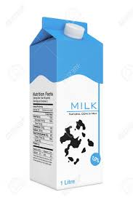
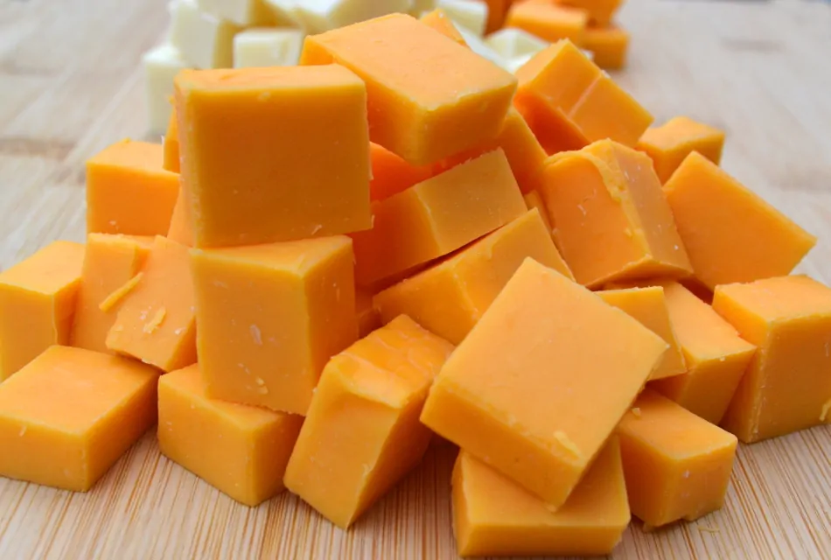
Dairy Products Evaluation – 4-H
4-H dairy products evaluation contest procedures(link)
Evaluate 5 milk samples for defects
Evaluate 5 cheddar cheese samples for defects
Identify 5 frozen desserts
Identify 4 samples as “real” or “artificial” dairy products

Slide 12
Resources for Dairy Products Judging
Deadline February 1st!
Saturday February 10th – Wilson County Fairgrounds
Dairy Products Judging Clinic - Senior High 4-H and FFA members across Tennessee are invited to participate in the clinic conducted by Dr. White.
Registration will begin at 9:00 am, with the clinic starting at 9:30 am. Lunch will be provided. Coaches and agents are welcome to participate in the clinic and learn all aspects of dairy product judging.
CONTACT: Jamie Harris jhharris@utk.edu
Know the Scorecard – from Mississipi State (for collegiate level)
http://dairyproductscontest.org/pdf/Mississippi-State-Dairy-Products-Judging.pdf
Sensory Evaluation of Milk – Penn State
http://dairyproductscontest.org/pdf/coaches_corner/Sensory-Evaluation-of-Milk-Penn-State.pdf

Slide 13
Grill Master Challenge
https://4h.tennessee.edu/food-science/
Lesson Plans & Guidelines available

Slide 14
Food Science Project Resources
Project Outcomes - https://4h.tennessee.edu/food-science/
Project Guide – Beginner
Activity Sheets – Beginner, Intermediate, Advanced
4-h Project Profile form
https://knox.tennessee.edu/wp-content/uploads/sites/202/2020/11/Section-A-112118-FINAL.pdf
Project e-PORTFOLIO Judging Rubric
https://4h.tennessee.edu/wp-content/uploads/sites/47/2021/01/Rubric-012920.pdf

Slide 15
Food Science Project Resources
External Resources
IFT K-12 Teaching Resources:
https://www.ift.org/community/educators/k12-teaching-resources
Search “Good Eats Videos” – with Alton Brown
Search “How it’s Made YouTube” – A lot of videos on commercial processing of food products from cheesecake to hot dogs to apple cider…
Search “Unwrapped” – more great videos on processing foods: Pringles, candies, Cheetos, mustard…

Slide 16
Project Profile – Goals

Slide 17
Project Profile – Activities

Slide 18
Project Profile – Presentations and Exhibits

Slide 19
Project Profile – Education and Skills
Items should clearly match the objectives and activities!

Slide 20
Food Science Project Resources
Food Safety – Recalls, Market Withdrawals, & Safety Alerts
FDA.gov
https://www.fda.gov/safety/recalls-market-withdrawals-safety-alerts
USDA.gov - https://www.fsis.usda.gov/recalls
Podcasts/blogs/websites
Food for Thought - https://www.foodprocessing.com/podcasts
Kitchen alchemy - https://blog.modernistpantry.com/
Cravings of a Food Scientist - https://cravingsofafoodscientist.com/
Abbey the Food Scientist - https://abbeythefoodscientist.com/
Nutrition meets Food Science - https://nutritionmeetsfoodscience.com/
Food Sci Notes - https://foodscinotes.com/
The Food Science Addict Podcast - https://thefoodscienceaddict.com/
Food Tech 101 - https://foodtech101.food.blog/
The Food Science Addict podcast - https://thefoodscienceaddict.com/
The Food Lab, serious eats - https://www.seriouseats.com/the-food-lab-5118015

Slide 21
Project Example 4-H Food Science Project
Kyla Adkins

Slide 22
Project Activities
Should be focused on the science behind foods
NOT BAKING OR COOKING
Research basic food science principles
Case study on products that intrigue them, favorite snack, or something they make often with their family
Students do not have to make a food product if unable to due to various reasons
Research to be able to relate and articulate principle learned

Slide 23
Activities
Look at food in pantry or grocery stores
What are foods are high in protein?
What is considered a “good source of protein”?
What are signs you should not use a food product?
What is the difference between best buy, sell by, and use by?
Look in your pantry and see if there is a pattern for foods that use best buy, if so why would this be?
Observe your family in the kitchen. Pick out a food safety ”rule” they should practice. How did that go?

Slide 24
Activities
Research a favorite snack that is sold in England
Is there anything different? Why?
If a student can purchase the UK version, they can try it and compare it with the US version to see if they notice a difference.
Kitchen Alchemy
Spherification
Gummies
Research favorite restaurant health inspection scores
Did their score surprise you? What did they get marked off for? What did past scores look like?

Slide 25
Case Study
Students should focus on one product that intrigues them, a favorite snack, or something they make often with their family
Become an “expert” on the product
Know the food science principal areas of their product
What are the functional ingredients?
Explain how some ingredients have a specific purpose in the food
What happens if you change a functional ingredient
What are products you have in your pantry that share properties with the food product?
Notes:
Student could even look up history of bread

Slide 26
Case Study – Example – Bread
Food Science principle
What are microbiology concerns with white bread?
How does microbiology help with making bread?
What are some sensory attributes for white bread?
Can you describe the process steps for making bread?
Mixing ingredients, proofing, baking, cooling, packaging
What is the FDA’s standard of identity for bread?
What ingredients are required?
Notes:
Mold, S. Aureus
Go into detail about yeast
Color, springy, moist, yeasty
Google FDA definition for bread

Slide 27
Case Study – Example – Bread
What is white bread?
What are the ingredients used in white bread?
What are the function(s) of each ingredient in bread?
How is bread commercially made?
Notes:
Students will have to research what a functional ingredient is

Slide 28
Case Study – Example –Bread
White bread is a food produced by baking yeast-leavened dough prepared from mixing starch, moistening products, and a leavening agent.
Ingredients can include flour, water, and yeast.
One functional ingredient that can be added to bread according to the FDA is lecithin. It acts as a dough conditioner. Dough conditioners help improve the consistency of bread.

Slide 29
Case Study – Example –Bread
Lecithin is an emulsifier, which is considered a dough conditioner.
Can come from egg yolks and soybean
Emulsifiers help to make a balanced dough, which results in a more uniform bread and crumb consistency.
Emulsifiers also help increase shelf life because they bind water.

Slide 30
Case Study – Example –Bread
Emulsifiers can be found in a variety of products because they help bind oil and water.
They are used in prepackaged and processed foods like mayonnaise, salad dressing, ice cream, and peanut butter.
Emulsifiers can be naturally occurring or man-made.

Slide 31
Case Study – Example –Bread
What causes bread to go bad?
Mold is caused by mold spores (found naturally in the environment or on your hands) contaminating the bread. Because bread has moisture and is kept at a perfect temperature, mold can grow easily.
Stale bread is caused by the starch crystallizing and hardening over time.
What makes bread safe?
Bread is usually baked at a high temperature for a long amount of time, which kills off bacteria that would be of concern.
Bacteria cannot grow because of bread’s low water activity.

Slide 32
Resources
Kitchen Alchemy – WTF and Education tabs
https://blog.modernistpantry.com/
https://science.howstuffworks.com/
https://www.compoundchem.com/
https://www.fda.gov/food
Code of Federal Regulations: https://www.ecfr.gov/current/title-21
https://foodinsight.org/
https://foodcrumbles.com/

Slide 33
Visualization of Project
Student could take a photos baking bread with and without a functional ingredient.
Include result pictures
A photo of a student giving a presentation about their product.
Include presentation
Student could make a fun, informative video about their case study.
Photos of student looking at food packaging for ingredients and/or nutrition facts

Slide 34
Contact info
Dr. Mark Morgan, Extension Specialist and Process Authority
Phone: 865-974-7499
Email: mark.morgan@tennessee.edu
Kyla Adkins, Student Engagement and Youth Programs
Phone: 865-974-4052
Email: kylaadkins@utk.edu
Food Science Department
2510 River Drive Knoxville, TN 37996
Phone: 865-974-7331
Email: foodsci_ext@utk.edu
Website: https://foodscience.tennessee.edu/food-science-extension/

